Slide 1



Concept, Nature, Process and Theories
By:-
Prof . Meghendra Gajpal
MCA, MCP, B Sc

Slide 2
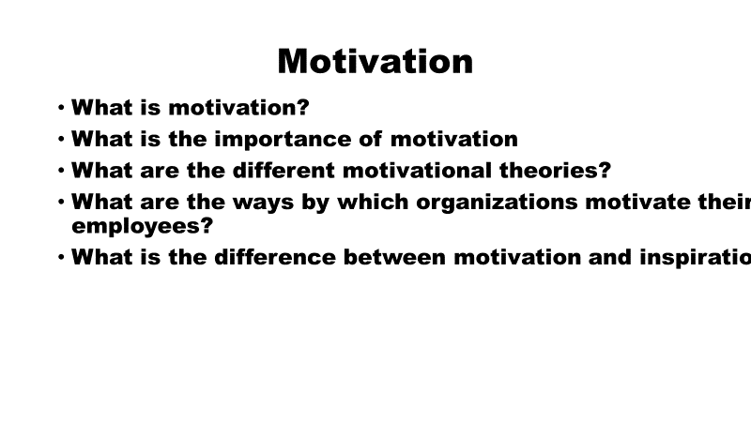

Slide 3


Motivation
Latin Word  Movere  To Move
Definition :
Motivation can be defined as an inner state that activates, energizes or moves behaviour towards goal.

Slide 4




Motivation
As the process that
accounts for an individual’s intensity, direction and persistence of effort toward attaining a goal.

Slide 5
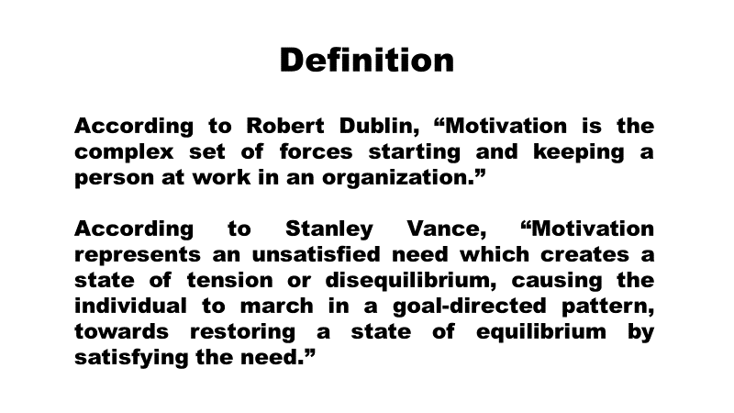
Motivation

Slide 6
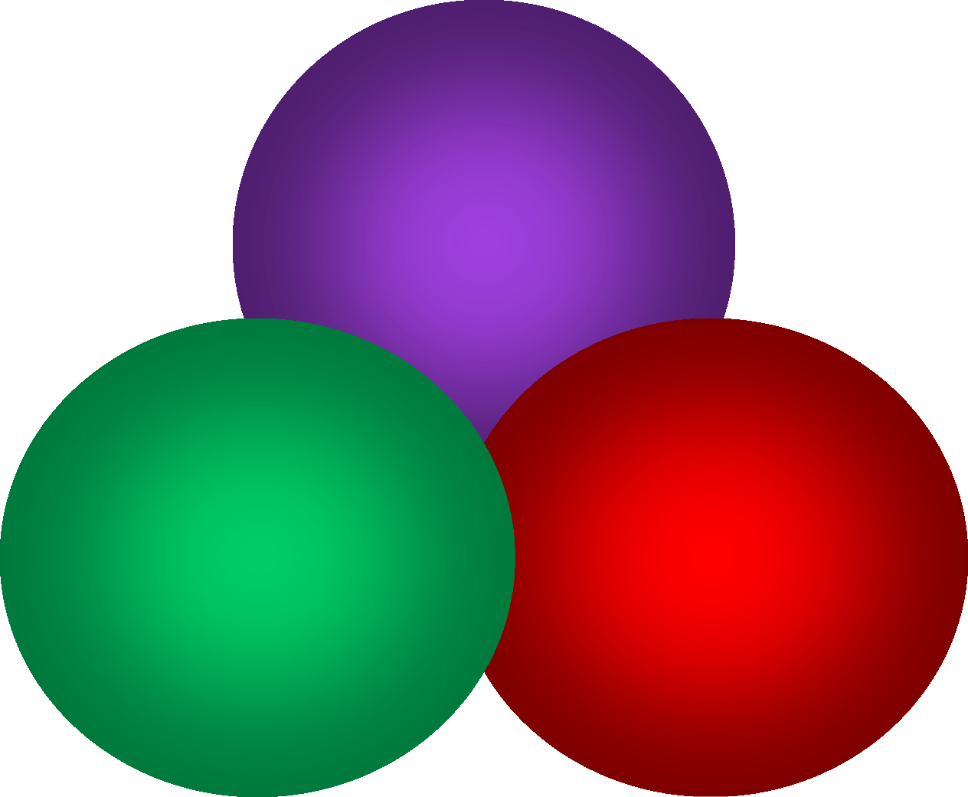
What Is Motivation?
Direction
Intensity
Persistence

Slide 7

Motivation
Intensity : how hard a person tries.
Direction: intensity needs to be channeled
in a direction favorable to the
a
organization for job satisfaction..
Persistence : a measure of how long person can maintain his or her effort…
Motivated individuals stay with a task long enough to achieve their goals.

Slide 8


Motivation: nature & importance
Nature
  One motive may result in many different behaviors
  Motives are the energizing forces within us
  The same behavior may result from many different motives
  Motives may operate in harmony or in conflict
  Motives come and go
  Motives interact with environment

Slide 9
Motivation: nature & importance
Importance
Performance = Ability x Motivation
Puts human resources into action
Improves level of efficiency of employees
Leads to achievement of organizational goals
Leads to stability of work force

Slide 10

Motivation Process
prompts the people to action, it activates the thrust towards reaching a goal
It is a series of activities under taken.
Behavior directed to attain goal
Motives creates a state of imbalance.
Attaining goal
restores it
Motive
Goal
Behavior
Tension Reduction

Slide 11

A Job Performance Model of Motivation
Individual Inputs
Ability, Job knowledge temperament & Traits Emotions, Moods, &Affect Beliefs & Values
Skills
Motivational Processes
Arousal
Attention & Direction
Intensity
&
Persistence
Motivated
Behaviors
Job Context
Physical Environment
Task Design
Rewards & Reinforcement Supervisory Support & Coaching
Social Norms
Organizational Culture
Enable, Limit

Slide 12

A Job Performance Model of Motivation (cont.)
Individual Inputs
 |  | Skills
Motivated Behaviors
Focus: Direction, What we do Intensity: Effort, how hard we try
Quality: Task strategies, the way we do it
Duration: Persistence, how long we stick to it
Motivational
Processes
Performance
Job Context
Enable, Limit

Slide 13

Model of Motivation
Mobilization
of Behaviour
Incentive
Unsatisfied Need
Tension
Drives
Drive Reduction
Satisfaction

Slide 14

Theories of Motivation
Content Theory
What Motivates
Process Theory
How motivates
Maslow’s Theory
Vroom’s
Expectancy Theory
Herzberg Two Factor Theory
Adam’s Equity
Theory
Alderfer’s ERG Theory
Goal- Setting Theory

Slide 15


Theories of Motivation: Content Theories
Content theories: Focus on factors within the person that energize, direct, sustain, and stop behavior. They attempt to determine the specific needs that motivate people (individual needs for job satisfaction, behavior, and reward systems). Aware of differences in people.

Slide 16
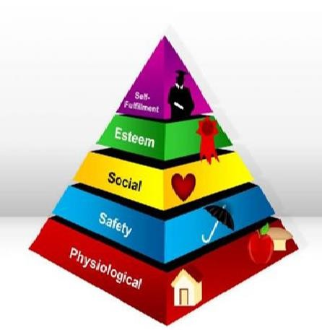
Theories of Motivation: Content Theories
Maslow’s Need Hierarchy
Abraham Maslow hypothesized that
within each human being , there exists a hierarchy of five needs –
Physiological – hunger, thirst, shelter and all bodily needs.
Safety – security & protection from
physical & emotional harm
Social – affection, belongingness, acceptance, friendship.
Esteem – internal esteem includes self-
respect, autonomy & achievement. External
esteem – status, recognition & attention.
Self-actualization – drive to become
what one is capable of becoming includes
growth, achieving one’s potential & self- fulfillment.

Slide 17

The theory states that although no need is ever fully gratified, a substantially satisfied need no longer motivates. According to Maslow, if you want to motivate someone, you need to understand what level of the hierarchy that person is currently on and focus on satisfying
those needs at or above that level.

Slide 18
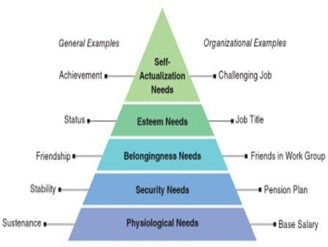

Slide 19
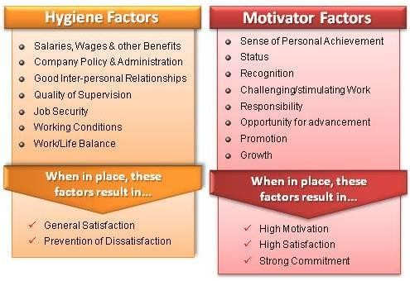
Theories of Motivation: Content Theories
Herzberg Two Factor Theory
Frederick Herzberg with the
belief that an individual's
relation to work is basic & that
one’s attitude toward work can
very well determine success or
failure proposed this theory.
According to him certain
characteristics tend to be
consistently related
to job
satisfaction & others
to job
dissatisfaction.
Intrinsic factors such as work
itself,
responsibility &
achievement seem to be related
to job satisfaction.
Extrinsic factors such as
supervision,
pay,
company
policies & working conditions
lead to job dissatisfaction.

Slide 20
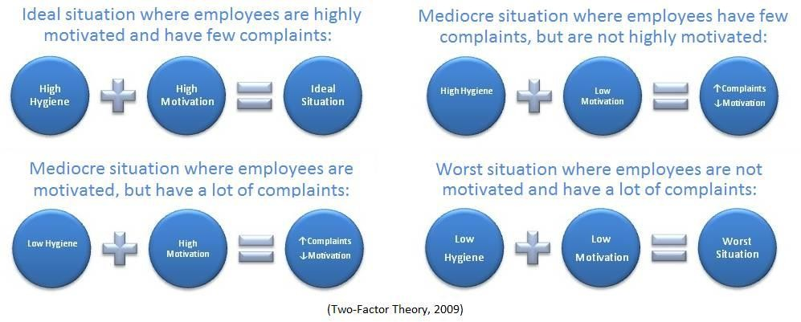

Slide 21
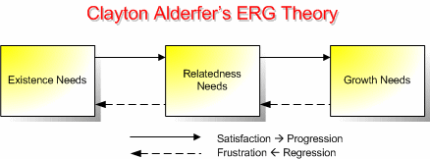
Theories of Motivation: Content Theories
Alderfer ERG Theory
Alderfer after reworking on Maslow’s
theory argued that the are three groups of core needs – existence, relatedness & growth.
Existence – concerned with providing our basic material requirements. They include the items of physiological and safety needs.
Relatedness – the desire for maintaining important interpersonal
relationship. Thus includes the social need.
Growth – an intrinsic desire for
personal development. This includes both self esteem and self actualization needs.

Slide 22
Relationship of all content theory of Motivation
Need Hierarchy
ERG
Two Factor Theory
Theory
Self Actualization
Growth
Motivation
Esteem
Relatedness
Belongingness
Security
Hygiene
Existence
Physiological

